Slide 1
SAMPLING MILK IN THE TRADE Jacqueline Odendaal
Notes:
Welcome and introduction.

Slide 2
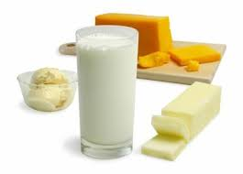
Dairy Standard Agency
Notes:
To show why sampling is such an important topic for us at Dairy Standard Agency, I decided to start the presentation with our background.
The DSA’s primary objective is promoting compliance of milk and other dairy products with product composition, food safety and metrology standards.
We have a responsibility towards the consumer and other role players in the market to ensure that the products offered for sale are safe for human consumption and comply with the legal specifications that are set out in the legislation.
The national monitoring of milk and dairy products (NMDP) is done in collaboration with municipal health authorities. It entails that milk and dairy product samples are taken quarterly throughout South Africa with the assistance of the EHP’s at local municipalities. DSA collects all the samples at the municipalities and testing is done at our DSA Laboratory.

Slide 3
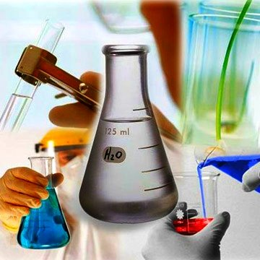
WHY IS THE TOPIC OF SAMPLING SO IMPORTANT?
FOUNDATION OF QUALITY CONTROL
Notes:
When we think of sampling, it is not a very complex procedure and for this reason sometimes underestimated and neglected.
We should pay more attention to sampling as it is the foundation of quality control. Effective sampling is crucial in order to obtain reliable lab test results. These results are used in production decisions and should therefore be accurate.
If the foundation of sampling is not strong enough the entire building of quality control will collapse!

Slide 4
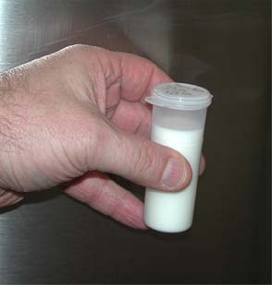
SAMPLING PROCEDURE
R328
ISO 707
SANS
314
Notes:
Regulation 328 (20 April 2007) relating to the powers and duties of inspectors and analysts conducting inspections and analyses of foodstuffs at food premises prescribes the procedure that an EHP must follow when taking a milk sample.
The International Standard ISO 707:2008 Milk and Milk products Guidance on sampling as quoted in R328 shall be followed during the sampling process. Just to mention that ISO 707 is adapted in SANS 314:2012.

Slide 5
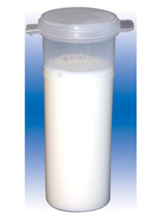
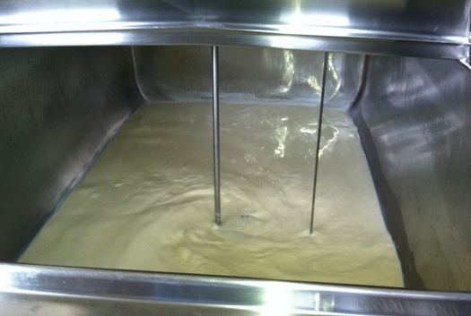
Definitions
Representative
Sample
TRUE REFLECTION
Notes:
Before any laboratory analysis can be performed a representative sample should be taken from the product to be evaluated. But what is a “representative sample?”:
Small amount taken from the bulk product (sample) that gives a true and accurate reflection of the bulk product (representative).

Slide 6
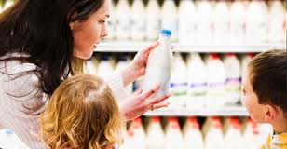
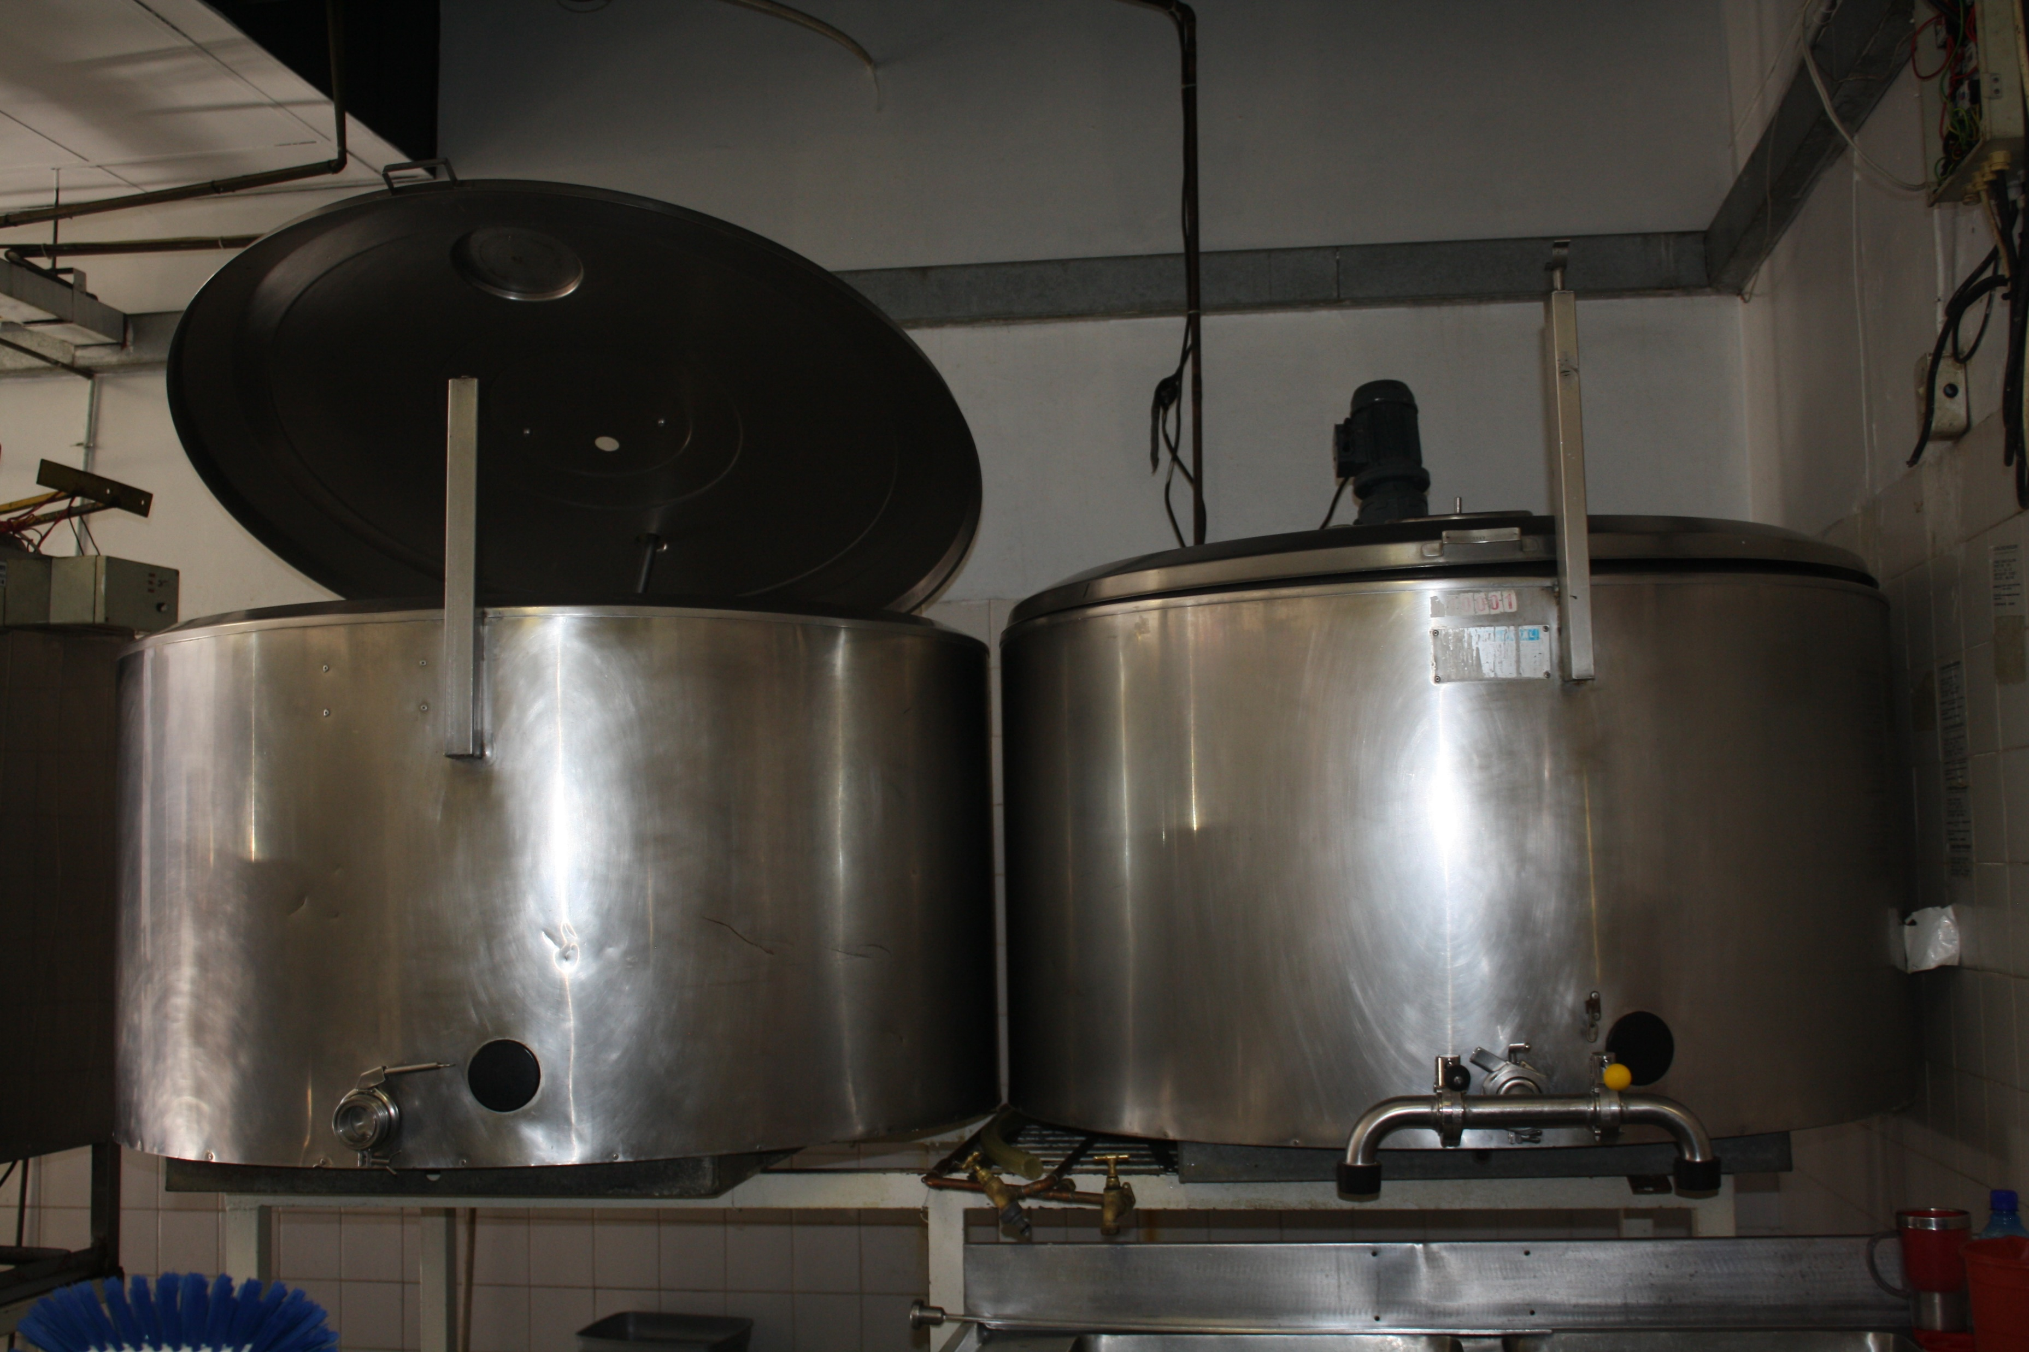
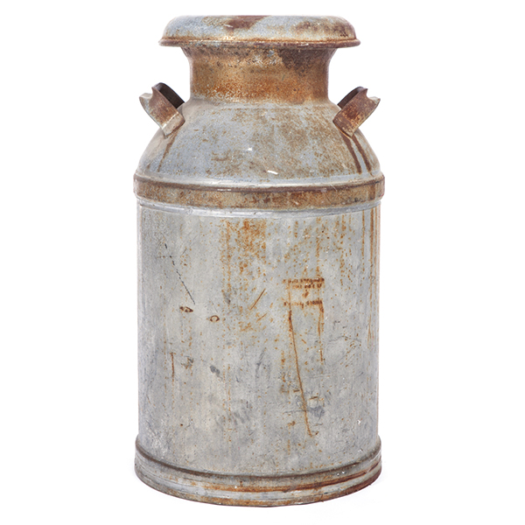
Sampling milk in the trade
Store shelf
Bulk tank
Milk can
Notes:
Sample the milk at the point of purchase i.e. the place where the consumer buys the milk:
From the store shelf
From a bulk milk tank in a retail outlet or
From a milk can kept in cold room (not the ideal, but unfortunately a reality)
It does not include taking samples on the farm who delivers milk to factories for further processing.

Slide 7
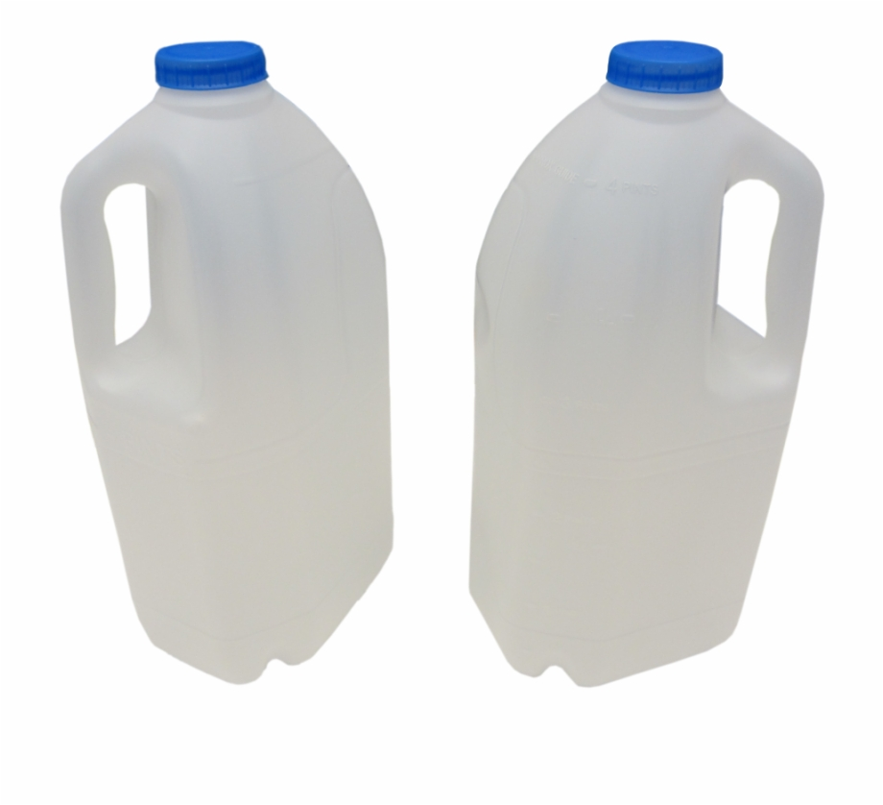
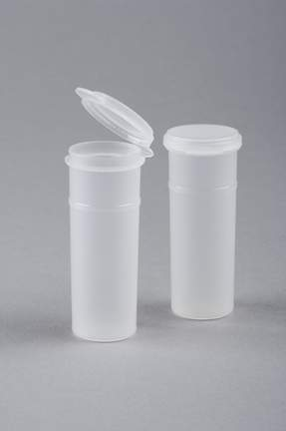
True reflection…
1
2
Hygiene & health
Containers
Notes:
We said that it is important that the sample should give a true reflection of the bulk product.
There are 4 things that the person taking the sample can do to ensure a true reflection:
Before any sample is taken the person should take care of personal hygiene & health to ensure that the sample is not cross-contaminated. (Cleaning & sanitizing hands, be in good health)
If the sample is taken from the store shelf the product is bought and kept in the original packaging material and NOT decanted in a smaller sample bottle.
When sampling from a bulk tank/milk can the sample bottle must be single-serve, plastic, securely closed, clean, dry & sterile.
DSA provides the 100ml sterile sample bottles for the National Monitoring Program, no other containers should be used.

Slide 8
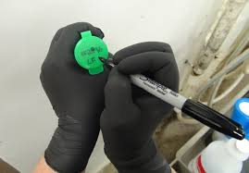
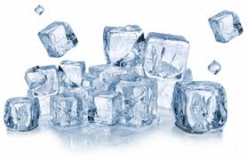
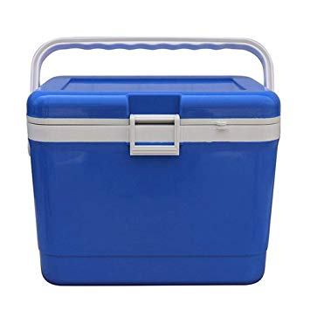
True reflection…
<5°C
Keep it cold
4
Marking of the sample
3
Notes:
We can also ensure a true reflection:
3. By proper marking of the sample and completing a processing form with the correspondent sample code. This way the samples and test results will not get mixed up. A permanent marker should be used and if a label is used make sure that it doesn’t cover the product information on the packaging material. Chané will give more information on the marking and completion of the processing form.
4. Samples should be kept cold (<5˚C) to prevent the growth of micro-organisms. A higher microbial count due to temp abuse after sampling will certainly not give a true reflection of the original product. A cooler box with ice or ice packs can be used for cooling.

Slide 9
Samples from shelf
When buying the product from the shelf make sure that:
Expiry date at least 2 days later than day on which samples are collected
Do not tamper with the original packaging material

Slide 10
Samples from bulk tank
Samples for micro tests taken first
Mixing of milk prior to sampling
Small vessels-transfer, stirring or plunging
Milk tanks-mechanical agitation least 5 min
-1-2 minutes for time programmed agitators
Large vessels-At least 5 min (30 min after filling)
-At least 15 min stored longer
Notes:
Samples for micro tests taken first using aseptic techniques with sterilized equipment. For the DSA samples only 1 sample is taken and therefore the sample bottle is sterile.
Mixing of milk prior to sampling-time of mixing depends on the size of the tank. Usually 5 minutes when tank capacity is 500-4000 liters.
See slide for mixing of milk in different size tanks.

Slide 11
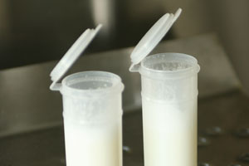
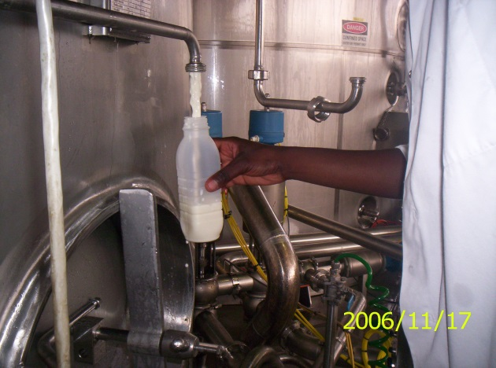
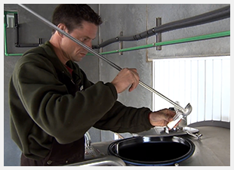
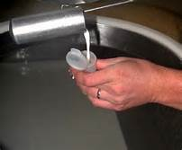
Samples from bulk tank
Always sample at the milk tap
Sample top of the tank (root cause)
Sampling from milk can
Notes:
Bulk tank at tap- sample at the milk tap and fill up ¾ of 100ml container. Do not touch the inner part of the lid and sample bottle.
Bulk tank at top-Only sample at the top e.g. root cause analyses and use sterilized, flamed dipper.
Sterilising agent (sampling equipment in contact with sampled product to be sterile). Alcohol can be used. Lighter/matches to flame dipper
Milk can-use the same method that the shop use to “scoop” the milk in for the customer.

Slide 12
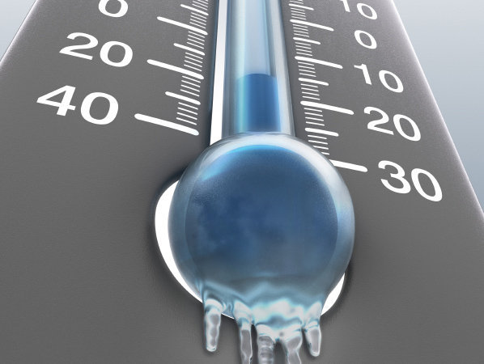
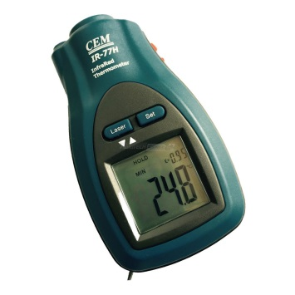
Maintaining cold chain
Keep cold during transport & storage
Record temperatures-Fridge/tank & Sample
Not frozen
No preservative added
to samples
Notes:
I can not over emphasise the importance of keeping samples cold and will end off my presentation with this slide.
Samples should be kept cold (<5˚C) during transport & storage.
By having all the temperature recordings we can make sure that the cold chain is not broken.

Slide 13
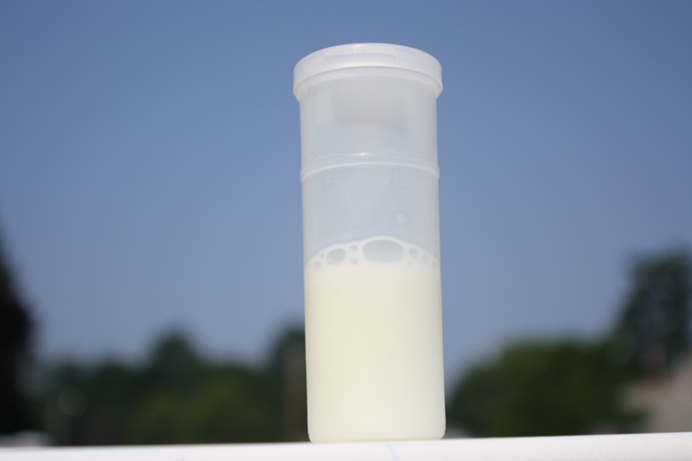
THANK YOU!

Slide 14
Challenges & Solutions
Chané Pretorius
Notes:
This part of the Presentation is aimed towards the EHPs who work very hard in submitting reputable samples to the DSA to regulate the quality of milk and dairy products offered for sale to consumers all over South Africa with our National Dairy Monitoring Program. I would like to thank you for your continuous support in working with us and in order to enhance this partnership, we need to improve some aspects that I would like to share with you today.

Slide 15
Avoid:
Expired / beyond use-by dates
Compromised
Non-dairy products
Samples outside current cycle sample run
Notes:
- We receive many samples for which we are grateful for, however we do experience some challenges. This includes incorrect or invalid samples being submitted, which may result in financial losses and misunderstandings.
Firstly, please check the dates on the samples and ensure that products aren’t sampled near their expiration or use-by dates (as Jacqueline has mentioned less than 2 days before the expiry date). It is not our policy to analyse products beyond the best before dates as it is not the objective of the project to determine the shelf life of products. We only determine whether or not a sample complies with microbiological requirements when offered for sale within the date printed on the packaging.
- Secondly, please do not sample compromised products as these would not be representative of the intended quality of the brand being tested.
Please do not buy Non-dairy products (e.g. dairy-free milk or cream, or margarine/fat spreads). Check for dairy ingredients in the ingredient’s list if you are uncertain.
Please make an effort to sample products from the smaller producers in your area, or the major producers that produce in your area of jurisdiction. We receive many duplicate samples from the same municipal areas, please communicate among yourselves to avoid this.
Not only do we want to protect the consumer’s safety, but we also want to assist the smaller business owners in staying on the right path and making a success of their businesses.
- Lastly, please make sure you sample the correct product type for the specific cycle as indicated by the DSA in e-mail communications (e.g. please don’t submit Amasi during the Cheese sample run). Due to high costs the lab only obtains consumables for a specific cycle’s analyses, therefore not all products can be tested at any given time as different products require different analyses.

Slide 16
Sampling Containers
Marking over labels/codes = cannot verify crucial information
Incorrect bulk sample containers → Use DSA bulk sampling bottles
Unmarked / inadequately marked sample = traceability compromised
Incorrect filling of bulk sampling bottles → Fill up to 100 ml line
Sample bottle’s lid open /spilled sample = will be discarded
Decanting of samples = Bad practice
Notes:
The second challenge we face is bulk sample containers.
Please only make use of 100 ml sampling bottles provided by the DSA. Other sampling bottles are not guaranteed to be sterile. Please let us know if your bottles have been depleted.
Only fill the sampling bottle up to the 100 ml filling line below the lid – if the sampling bottle is too full it makes analysing difficult, and the sample may become compromised.
Do not decant milk from a larger container into the bulk sampling bottle – it is unethical and the product will become contaminated. Rather submit the larger bottle for analysis if that is how the milk is being sold.
Ensure the lid of the sampling bottle is closed tightly to safeguard the integrity of the sample. Any compromised product will be discarded as such results will be invalid.
Remember to mark the sample according to the sample code designated by you. When marking the sample, use a permanent marker that will not rub off, especially if the sample may become wet. It is also useful to mark the sample on two locations on the sampling bottle, or to include the name of the company or milk shop.
Make certain the sample code marked on the sample corresponds to the sample code as indicated by you on the PF.
With regards to packed/packaged samples: As Jacqueline has mentioned, avoid marking over the labels or batch codes as the information obtained from the label is critical to assign the sample to a specific class which entails certain analyses, and also to verify use-by dates and batch codes on the sample.

Slide 17
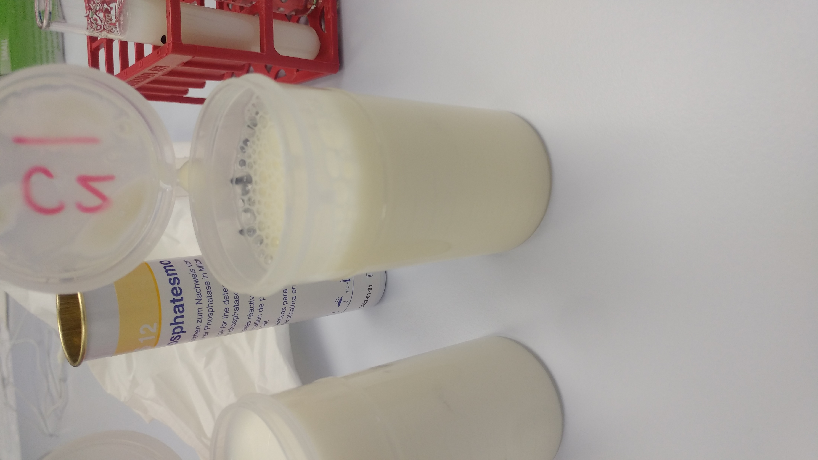
✓
Notes:
Here is an example of a bulk sampling bottle which has been Filled correctly as opposed to one that has been overfilled. You can see the bottle has been filled beyond the filling line.

Slide 18
Municipality code / Cycle / Sample code
Extra info
✓
Notes:
Here is an example of an inadequately marked sample. Ice water and the subsequent handling of the bottle had almost completely wiped off any information needed to trace the sample back to its origin.
However, here we can see how a bulk bottle should be marked. The municipality code, cycle, and sample code are written neatly, a bonus is that it has be written on two locations on the bottle and an extra “clue” has been given which is the milk shop’s name. It may seem like a tireless effort, but I assure you the correct marking of a sample is invaluable. If this step is compromised, all is compromised.

Slide 19
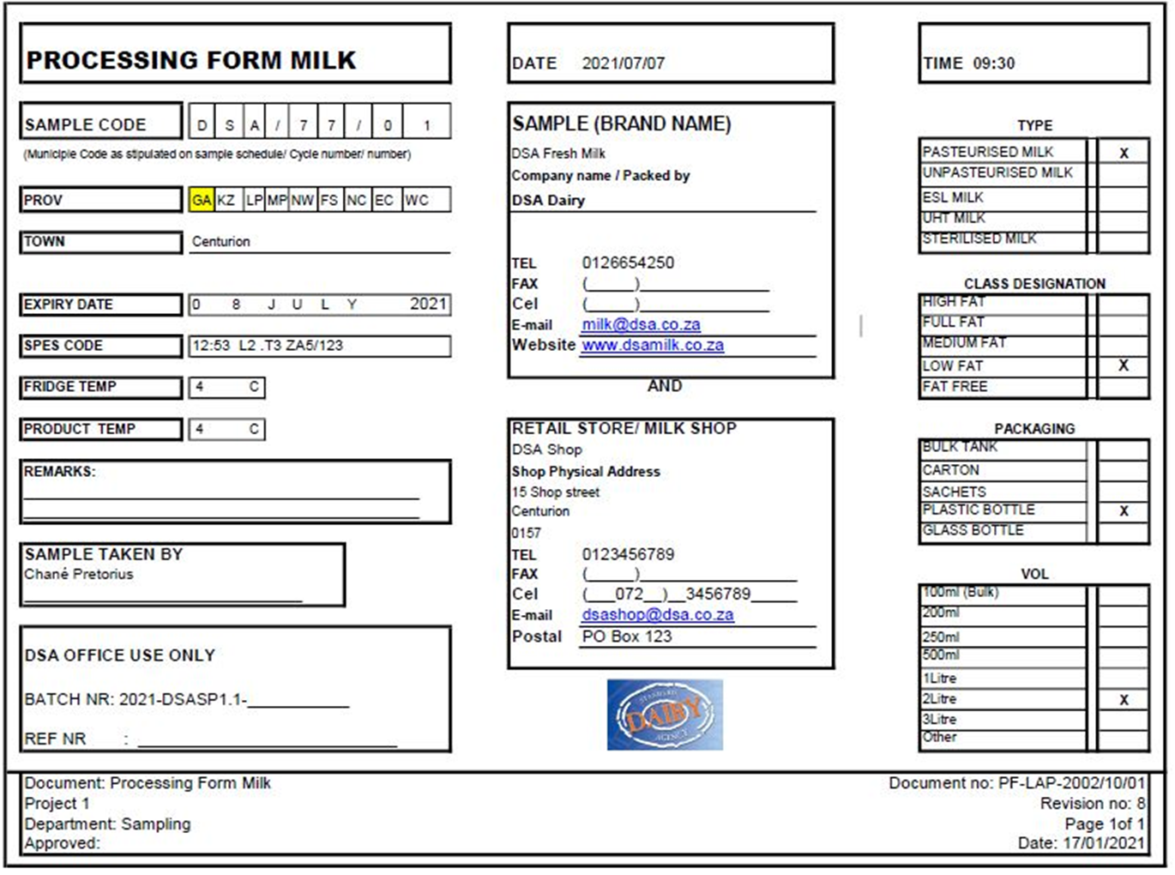
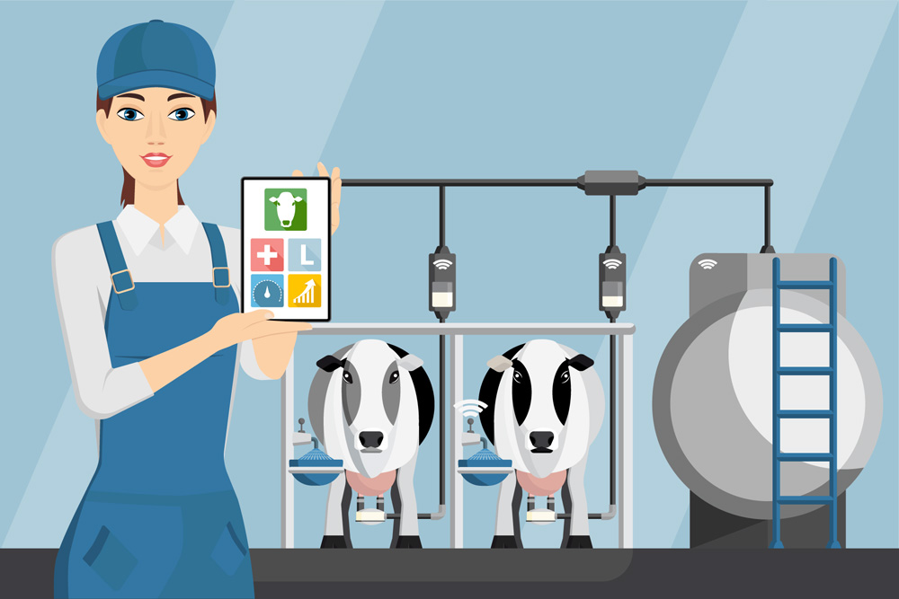
PROCESSING FORM
TRACEABILTY
https://www.keytoxicology.com/sustainable-dairy-chain/
Notes:
Our last challenge is the processing form. This form facilitates the ability to trace a non-conforming product’s origin, therefore, the sample’s processing form is undeniably imperative!
I will first discuss the challenges that we face when receiving processing forms from EHPs, and then I will discuss how to correctly complete the PF.
Please make sure you are provided with the latest PF from the DSA. It is usually included in the communication with authorities before a cycle run takes place.

Slide 20
1.
Incomplete
→ Complete ASAP, Double check
2.
Handwriting unclear
→ Write legibly / type out
3.
No municipality code provided
→ Provide Correct Municipality code (https://municipalities.co.za)
Notes:
- The biggest challenge we face is an incomplete PF. Although we understand how strenuous such a form may be, the information it contains is vital, therefore, please complete it completely directly after sampling, even better so - in the store.
- Secondly, Please write legibly as a bad handwriting can lead to bad interpretations.
- The municipality code should be provided as this is important to trace the sample back to the correct EHP, and to ensure that the correct EHP receives their results. If you are uncertain about your municipality code, please visit https://municipalities.co.za

Slide 21
4.
Sample code invalid
→ Numerical Sample Code
5.
Multiple samples with the same codes
→ Verify sample codes with fellow EHPs
6.
Sample type not indicated
→ Fill in on form ASAP / Ask shop for details / write it out
Unique to each sample
Notes:
- Another issue is that sample codes assigned to the sample by the EHP are invalid. The sample code is extremely important for traceability. This code must be numerical and not in letters, please.
Please make sure that duplicate sample codes are not used in error among EHPs from the same Municipality code.
Then, the sample type must please be indicated e.g. pasteurised milk, raw milk, cream, Amasi or butter etc. (this can be written out on PF if no space is provided). The sample type is especially important when it comes to bulk milk, because it does not contain a label to indicate raw or not – if you are uncertain, please indicate so.
Different tests are performed on raw and pasteurised milk-Phosphatase test on pasteurised milk and CA on raw milk. Incorrect indication of raw/pasteurised milk will lead to the wrong test performed (waste of money and meaningless results).

Slide 22
7.
Sample not marked
Cannot verify product against processing form.
8.
No Company / Brand name provided
→ Fill in on form / Consult shop
9.
Expiry dates / batch codes
→ Should be provided in the designated space on the processing form
→ Mark sample with permanent marker, or provide a complete description of sample (including Use-by Date & Batch code)
Notes:
- Often the samples are not marked, and this may cause a mix-up of samples. It is easier for us to verify traceability if use-by dates or batch codes are provided on the PF
- Please provide the company/brand name (especially bulk milk that does not contain any label to verify the company), and also indicate where the sample was taken as this is also important for traceability.
- The use-by date must be filled in on the space provided for the use-by date on the PF in order to match the correct sample with the relevant PF. This also assists us in identifying samples.
- Also note that the space provided for the Batch code on the PF is only intended for the batch code of the sample, and not for other internal codes.

Slide 23
https://www.tekstina-tech.si/sustainaibility/tracebility/
Notes:
In the end the best practice is to fill out the processing form in the store, or directly after taking the sample. So let’s take a walk through the DSA PF…

Slide 24
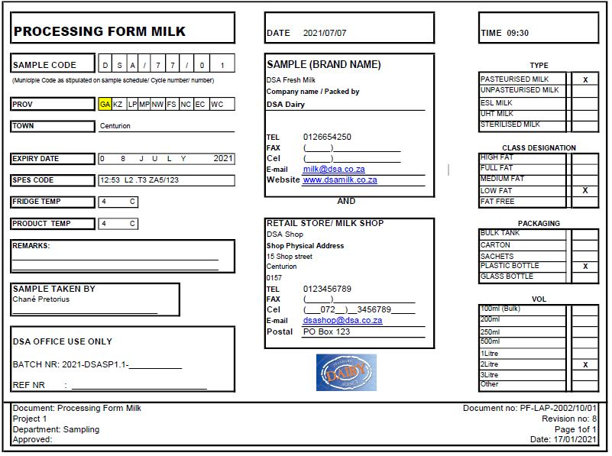
Notes:
This is a typical example of a PF completed correctly….
If you are uncertain about anything with regards to processing forms or bulk milk bottles, please feel free to contact me.

Slide 25
THANK YOU!
Notes:
In one of our upcoming webinars Jacqueline will be discussing the interpretation of results that are received from the DSA, so please be sure to listen in as we rely on you to take these results further and make a difference by doing the great work that you do.

